Slide 1
Sparse Modelling
Model Selection

Slide 2
Sparse Modelling
Model Selection
Lots of this is based on work with Josh Jahner, Alex Buerkle and the Modelscape Consortium

Slide 3
Learning objectives
Understand inference vs in-sample vs out of sample prediction
Understand reducible vs irreducible error
Simulate data for analysis
Run 1 type of sparse analysis on simulations, extract inference, IS, OS predictions
Contrast results with other techniques

Slide 4
How do we decide which parameters to include?
Population density~environment
Phenotype~genotypes (or expression)
Primary productivity ~ remote sensed river parameters
Notes:
What do all of these data sets have in common?
Could we put them into a regular linear model? Why not?
So what can we do?
Looking for AIC, looking for drop one pvalues.
What are the problems with these?
Drop one is anticonservative, AIC doesn’t aid in prediction

Slide 5
Purpose of Sparse Modelling
Choose among predictor values when n<<p
Increases interpretability of models
Prevents overfitting
Notes:
NOT SURE IF I STILL LIKE THIS SLIDE

Slide 6
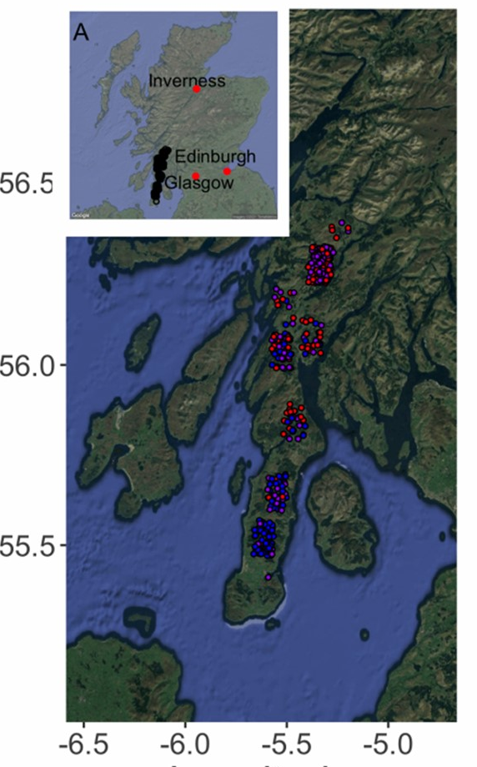
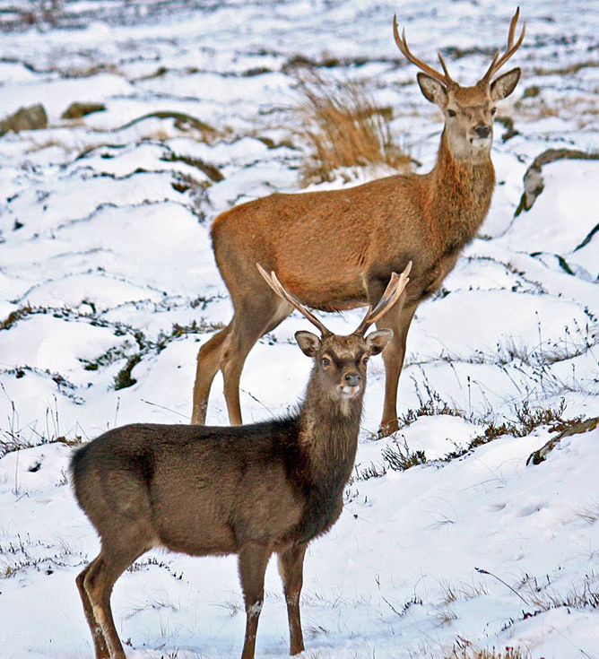
Some example data:
386 deer with phenotypes, ~45,000 SNPs

Slide 7
Some example data:
386 deer with phenotypes, ~45,000 SNPs

Slide 8
Some example data:
386 deer with phenotypes, ~45,000 SNPs

Slide 9
Carcass mass ~sex + age +SNP1+SNP2+SNP3+SNP4+SNP5+SNP6+SNP7+SNP8+SNP9+SNP10
Notes:
PVE = 0.912
PGE = 0.598

Slide 10
Carcass mass ~sex + age +SNP1+SNP2+SNP3+SNP4+SNP5+SNP6+SNP7+SNP8+SNP9+SNP10
Notes:
PVE = 0.912
PGE = 0.598

Slide 11
What’s missing in the deer model?
Carcass mass ~sex + age +SNP1+SNP2+SNP3+SNP4+SNP5+SNP6+SNP7+SNP8+SNP9+SNP10

Slide 12
What’s missing in the deer model?
Carcass mass ~sex + age +SNP1+SNP2+SNP3+SNP4+SNP5+SNP6+SNP7+SNP8+SNP9+SNP10
+ error?
Notes:
How can we break down error?

Slide 13
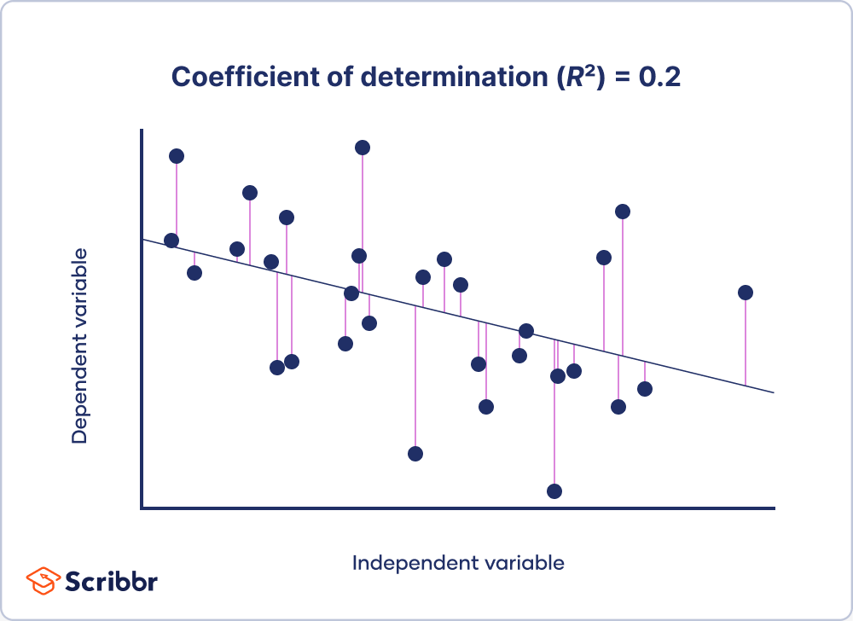
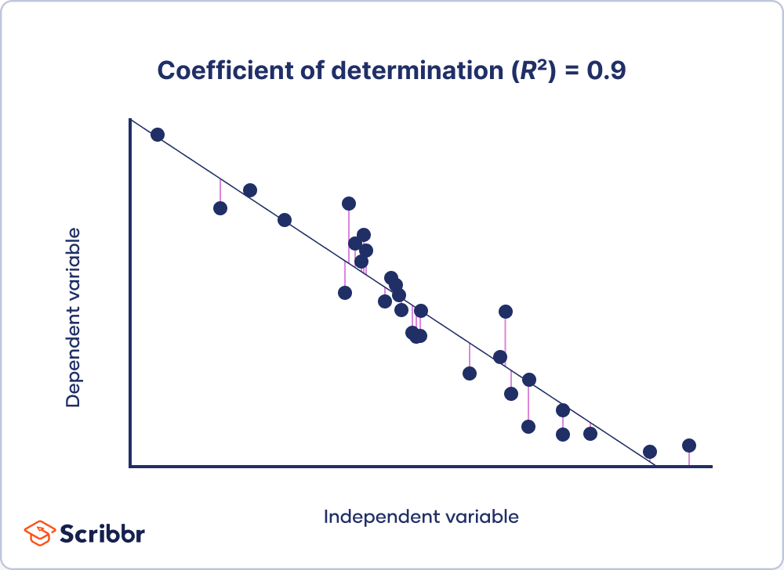
https://www.scribbr.com/statistics/coefficient-of-determination/
Notes:
We can think a bit about how much of the variation is explained in each model.
We can think about these are R2s, we can also think about root mean squared error. Basically, we interested in how much variation in the trait remains unexplained after we’ve explained using the parameters we’re interested in.

Slide 14
Inference?
In sample prediction?
Out of sample prediction?

Slide 15
Inference – which parameters are associated with a response
In sample prediction – accurate predictions about the sampled pop
Out of sample prediction – generalizations about pops for which we have no prior information
Notes:
We do a lot of inference in ecology and evolution – what are some examples of this?
When do we do in sample prediction?! – This is our R2 most of the time
When do we do out of sample prediction?

Slide 16
Out-of-Sample R²
In-Sample R²
Notes:
Grey box is the reproduceable error. This is the most that we could ever explain, because this is what is explained by causal parameters. The rest is due to chance.
Is this something we can know for any given trait before we get out there?

Slide 17
Notes:
Simulations that we did, where we simulated the number of N on the top, the number of parameters on the right side, 10 causal parameters for each of the betas.
Grey is the reducible error, white is the irreducible error – we are wrong if we’re thinking we’re explaining the white here.
Ignore the points – these are the punch lines of how well each of these methods did in each of these scenarios – stand by for the paper!
What I want you to get from this is that it’s really a small target when beta is small!
We’re trying to hit the top right corner of the grey box. Except we don’t know how large the grey box really is when we start out. And remember what that means for the r2 even if we do it well – our prediction is kind of out of our control because of the processes that lead to the response variable.

Slide 18
Some sparse modelling techniques
Ridge Regression
LASSO
Elasticnet
Susie
BSLMM
Random Forest
Notes:
Have you heard of these (pause for response because they talked about random forest last week!)

Slide 19
Some sparse modelling techniques
Ridge Regression
LASSO
Elasticnet
Susie (used in genomics, happy to chat)
BSLMM (used in genomics, happy to chat)
Random Forest

Slide 20
Some sparse modelling techniques
Ridge Regression
LASSO
Elasticnet
Susie (used in genomics, happy to chat)
BSLMM (used in genomics, happy to chat)
Random Forest (?) won’t talk about again today

Slide 21
Some sparse modelling techniques
Ridge Regression
LASSO
Elasticnet
Susie (used in genomics, happy to chat)
BSLMM (used in genomics, happy to chat)
Random Forest (?) won’t talk about again today
-> a lot of these are considered ‘machine learning'
Notes:
These are methods that are only recently being implemented in ecology and evolution – this is a big part of what my most recent postdoc was on, and a paper that we’re soon to submit.
There is a need for these in ecology and evolution – because they help to sort out the n<<<p problem.

Slide 22
Ridge Regression
Constraint on the coefficients, using a penalty term λ
When λ equals 0, ridge regression is basically a linear regression

Slide 23
Ridge Regression
Sum of squares for training data is small
y
X
Awesome for sparse modelling because: while least squares needs at least n=p to estimate sum of squares, ridge regression can find a solution using cross validation

Slide 24
Ridge Regression
Sum of squares for training data is small
Sum of squares for testing data is large
Ridge regression purposely doesn’t fit the training data as well, so that it fits the testing data better
This is known as ‘shrinkage’ or ‘regularization’
y
X
Awesome for sparse modelling because: while least squares needs at least n=p to estimate sum of squares, ridge regression can find a solution using cross validation

Slide 25
Ridge Regression
Sum of squares for training data is small
Sum of squares for testing data is large
Ridge regression purposely doesn’t fit the training data as well, so that it fits the testing data better
This is known as ‘shrinkage’ or ‘regularization’
y
Ridge minimizes sum of squares + λ*slope²
This makes predictions of y less sensitive to changes in x
X
Choose λ using cross validation
Awesome for sparse modelling because: while least squares needs at least n=p to estimate sum of squares, ridge regression can find a solution using cross validation

Slide 26
Lasso and Ridge are really similar
Ridge: sum of squared residuals + λ*slope²
Lasso: sum of squared residuals + λ*|slope|
Both make predictions of y less sensitive to x from a small training dataset
Ridge can only shrink the slope close to 0, while LASSO can shrink it all the way to 0 – makes it easier to get rid of useless variables
ElasticNet uses both Ridge and Lasso depending on the variable.

Slide 27
Lasso and Ridge are really similar
Ridge: sum of squared residuals + λ*slope²
Lasso: sum of squared residuals + λ*|slope|
Both make predictions of y less sensitive to x from a small training dataset
Ridge can only shrink the slope close to 0, while LASSO can shrink it all the way to 0 – makes it easier to get rid of useless variables
ElasticNet uses both Ridge and Lasso depending on the variable.

Slide 28
Today:
We’re going to simulate some data, and run some sparse models.
I’m going to give you the code
3 levels
Get the code to work for each of the methods (as given to you)
Implement the code for a new data set (code not given)
Understand inference, in sample and out of sample for this new data set

